Slide 1
Financial Management
Lecture 6: Time Value of Money

Slide 2
Financial Decision Making
Pre-Test:
Which of the following amounts would you rather have?
A$1000 today
A$1050 in one year if the interest rate is 10%
€730 if €1.00=A$1.30
0.60 ounces of gold if gold is worth A$1600/oz
No idea how to compare!
k
Notes:
A. PV=1000
B. PV=954.55
C. PV=949
D. PV=960

Slide 3
Three Basic Ideas in Finance
Time Value of Money
Arbitrage / Law of One Price
Diversification
Notes:
If you understand these ideas and are able to apply them to real world problems, then you will do well in this course!

Slide 4
Valuation Decisions
Identify Costs and Benefits
    Will require input from Marketing, Economics, Organisational Behaviour, Strategy, Operations, etc.
Costs and Benefits must be compared at the same point in time
    By convention we usually choose today (present value)
Costs and Benefits must be compared using the same measure
    By convention we usually choose domestic currency (A$)

Slide 5
Analysing Costs and Benefits
Suppose a jewellery manufacturer has the opportunity to trade 35 ounces of platinum and receive 30 ounces of gold today.
    To compare the costs and benefits, we first need to convert them to a common unit.
Notes:
Discuss possible strategies:
Could compute how much platinum she could purchase with money from selling the gold (or vice versa)
Could look up prices of both metals in terms of some other commodity (i.e. barter economy)
Could look up prices of both metals in GBP, AUD, JPY, etc

Slide 6
Analysing Costs and Benefits
If gold is worth $1750/ounce, then
    (30 oz. of gold) X ($1750/oz.) = $52,500 today
If platinum is worth $1600/ounce
    (35 oz. platinum) X ($1600/oz.) = $56,000 today
So, this opportunity has a benefit of $52,500 today and a cost of $56,000 today.
    Net value = benefit – cost = –$3,500
Net value is negative, the costs exceed the benefits and the jeweller should reject the trade.

Slide 7
Using Market Prices to Determine Cash Values
Competitive Market
    A market in which goods can be bought and sold at the same price.
In evaluating the jeweller’s decision, we used the current market price to convert from ounces of platinum or gold to dollars.
    We did not concern ourselves with whether the jeweller thought that the price was fair or whether the jeweller would use the silver or gold.

Slide 8
Try It…
Your car recently broke down and it needs $2,000 in repairs. But today is your lucky day because you have just won a contest where the prize is either a new motorcycle with a MSRP of $15,000, or $10,000 in cash. You do not have a motorcycle license, nor do you plan on getting one. You estimate you could sell the motorcycle for $12,000. Which prize should you choose?
A. Motorcycle
B. $10,000 cash
C. Depends on whether I want a motorcycle
D. Where do I start?
k
Notes:
Solution:
Competitive markets, not your personal preferences (or the MSRP of the motorcycle), are relevant here: One Motorcycle with a market value of $12,000 or $10,000 cash. Instead of taking the cash, you should accept the motorcycle, sell it for $12,000, use $2,000 to pay for your car repairs, and still have $10,000 left over.
In fact, the car repairs are irrelevant to your decision. All that matters is that you could have $12,000 in cash by selling the motorcycle, or $10,000 in cash by taking the cash prize. It all boils down to $12,000>$10,000!
Note that, in finance, we assume you can BUY or SELL anything at the same price. If you’re selling for 12,000, then someone else is buying at 12,000 – in the absence of market frictions (transaction costs, taxes, restrictions on who can buy or sell), there is only one value for every asset!
If you wanted the motorcycle, would MSRP be relevant? Not if the market is competitive and you can buy the motorcycle for the same price as you can sell it for ($12,000).

Slide 9
Example
You are offered the following investment opportunity:
    In exchange for $40,000 today, you will receive 2,500 shares of stock in the Ford Motor Company and 10,000 euros today.
    The current market price for Ford stock is $9 per share and the current exchange rate is $1.50 per €.
Should you take this opportunity?

Slide 10
Solution
Benefits:
  Ford Stock
  Euros
  Total
Costs:
Benefits – Costs:
  2,500×$9= $22,500
  €10,000×$1.50=$15,000
  ———
  $37,500
  $40,000
–$2,500
Notes:
The costs and benefits must be converted to their cash values. Assuming competitive market prices:
2,500 shares × $9/share = $22,500
€10,000 × $1.50/ € = $15,000
The net value of the opportunity is $22,500 + $15,000 - $40,000 = -$2,500, we should not take it.

Slide 11
Follow up…
  Would your decision change if you believed the value of the euro would rise over the next month?
  Yes, we should use next year’s euro exchange rate in our computation because we plan to hold our investment for a year
  Yes, that will increase our return from holding the euros
  No, only today’s prices matter
  No, higher euro value will reduce the demand for Fords in Europe, so there will be no change in the total value of Ford + euros
k
Notes:
This value depends only on the current market prices for Ford and the euro.
Our personal opinion about the future prospects of the euro and Ford does not alter the value the decision today.
With this deal we are buying Ford + euros today (not one year from now). In a competitive market the prices will reflect market consensus.
If we think the euro will rise, then we’re better off buying euros directly at the current exchange rate of $1.50, rather than buying them in this package.

Slide 12
Time Value of Money
Consider an investment opportunity with the following certain cash flows.
    Cost: $100,000 today
    Benefit: $105,000 in one year
We can’t compare dollars today directly with dollars in the future.
    There is a time value to having money today that makes $1 today worth more than $1 in one year

Slide 13
The Interest Rate: An Exchange Rate Across Time
The rate at which we can exchange money today for money in the future is determined by the current interest rate.
  Suppose the current annual interest rate is 7%. By investing or borrowing at this rate, we can exchange $1.07 in one year for each $1 today.
    Risk–Free Interest Rate (Discount Rate), r_{f}: The interest rate at which money can be borrowed or lent without risk.
      Interest Rate Factor = 1 + r_{f}
      Discount Factor = 1 / (1 + r_{f})

Slide 14
The Interest Rate: An Exchange Rate Across Time
Will we invest?
    Cost = $100,000 today, Benefit = $105,000 in one year
If the interest rate is 7%
    Cost = ($100,000 today)
    × (1.07 $ in one year/$ today)
    = $107,000 in one year
Since we will have more if we put our $100,000 in the bank, we will NOT invest
Benefit – Cost = –$2000 in one year
Notes:
Value of Investment in One Year
Both costs and benefits are now in terms of “dollars in one year,” so we can compare them and compute the investment’s net value:
$105,000 − $107,000 = −$2000 in one year
In other words, we could earn $2000 more in one year by putting our $100,000 in the bank rather than making this investment. We should reject the investment.
NB: We have compared FUTURE values here. We’ll get the same answer comparing PRESENT values on the next slide.

Slide 15
The Interest Rate: An Exchange Rate Across Time
Will we invest?
    Cost = $100,000 today, Benefit = $105,000 in one year
If the interest rate is 7%
    Benefit = ($105,000 in one year)
    ÷ (1.07 $ in one year/$ today)
    = $98,130.84 today
Since the bank will only lend us $98,130.84 today for $105,000 in a year, we will NOT invest
    Benefit – Cost = –$1869.16 today
Notes:
Value of Investment Today
Consider the benefit of $105,000 in one year. What is the equivalent amount in terms of dollars today?
Benefit = ($105,000 in one year) ÷ (1.07 $ in one year/$ today)
= ($105,000 in one year) × 1/1.07 = $98,130.84 today
This is the amount the bank would lend to us today if we promised to repay $105,000 in one year.

Slide 16
Present Versus Future Value
If we convert from dollars today to dollars in one year,
    (−$1869.16 today) × (1.07 $ in one year/$ today) = −$2000 in one year.
The two results are equivalent, but expressed as values at different points in time.

Slide 17
Present Versus Future Value
When we express the value in terms of dollars today, we call it the present value (PV) of the investment.
When we express the value in terms of dollars in the future, we call it the future value (FV) of the investment.

Slide 18
Discount Factors and Rate
We can interpret
as the price today of $1 in one year. The amount is called the one- year discount factor.
The risk-free rate is also referred to as the discount rate for a risk-free investment

Slide 19
Try It
The cost of replacing a fleet of company trucks
with more energy efficient vehicles was $100 million in 2011.
The cost is estimated to rise by 8.5% in 2012.
If the interest rate was 4%, what was the cost of a delay in terms of 2011 dollars?
$8.50m
$4.33m
$8.17m
$4.0m
k
Notes:
No TVM = .085x100
Correct
Pv of 8.5m = 8.5/1.04=8.17m
Don’t know where to start

Slide 20
Solution
If the project were delayed, its cost in 2012 would be:
  $100 million × (1.085) = $108.5 million
Compare this amount to the cost of $100 million in 2011 using the interest rate of 4%:
  $108.5 million ÷ 1.04 = $104.33 million in 2011 dollars.
The cost of a delay of one year would be:
  $104.33 million – $100 million = $4.33 million in 2011 dollars.
Notes:
Solution numbers are present, but are covered. They will show up as the slide animates. Use outline view to see them while editing

Slide 21
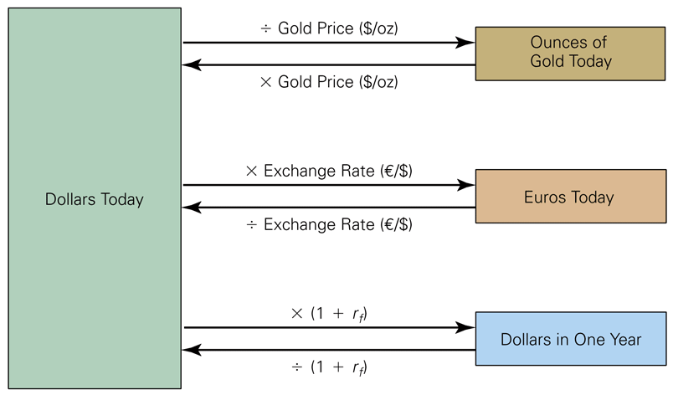
Converting Between Dollars Today and Gold, Euros, or Dollars in the Future

Slide 22
Pre-Test
You’ve been promised $2000 in 2 years. Which formula would you use to compute the value of that promise today? Assume the relevant interest rate is 3% p.a. (compounded annually).
,
,
,
k

Slide 23
The Timeline
Assume that you are lending $10,000 today and that the loan will be repaid in two annual $6,000 payments.
  The first cash flow at date 0 (today) is represented as a negative number because it is an outflow.
Year 1
Year 2
Date
0
1
2
Cash Flow:
−$10,000
$6000
$6000
Today
End Year 1
Begin Year 2
Notes:
A timeline is a linear representation of the timing of potential cash flows.
Drawing a timeline of the cash flows will help you visualize the financial problem.
Differentiate between two types of cash flows
Inflows are positive cash flows.
Outflows are negative cash flows, which are indicated with a – (minus) sign.
Timelines can represent cash flows that take place at the end of any time period – a month, a week, a day, etc.

Slide 24
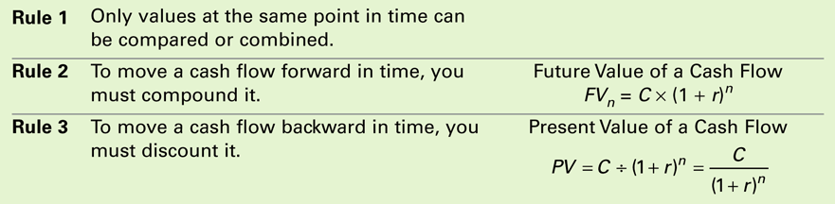
Three Rules of Time Travel
Financial decisions often require combining cash flows or comparing values. Three rules govern these processes.
Table 4.1 The Three Rules of Time Travel

Slide 25
The 1st Rule of Time Travel
It is only possible to compare or combine values at the same point in time.
  Which would you prefer: A gift of $1,000 today or $1,210 at a later date?
  To answer this, you will have to compare the alternatives to decide which is worth more.
    How long is “later?”

Slide 26
The 2nd Rule of Time Travel
To move a cash flow forward in time, you must compound it.
  Suppose your choice is between receiving $1,000 today or $1,210 in two years. You believe you can earn 10% on the $1,000 today.
Step 1: Construct a timeline:
years
0
1
2
A:
$1000
B:
$1210

Slide 27
The 2nd Rule of Time Travel
Step 2: Move cash flow forward by compounding
Future Value of a Cash Flow:
years
0
1
2
$1000
$1100
$1210
× 1.10
× 1.10
Notes:
So we are indifferent between 1000 today and 1210 in 2 years under the assumed interest rate!

Slide 28
Example
Suppose you have a choice between receiving $5,000 today or $10,000 in five years. You believe you can earn 10% on the $5,000 today, but want to know what the $5,000 will be worth in five years. Use the formula FV=PV(1+r)^n. Which of these is wrong?
PV=5000
n=5
FV=10000
r=0.10
Notes:
A bit of a trick question. But if you look at the question as asking what 5000 is worth in 5 years, then FV is unknown. You then compare the result to 10000 to decide which choice is better. OR PV is unknown – you can compare PV of 10000 to 5000 today.

Slide 29
Solution
0
1
2
3
4
5
$5,000 today is worth $8,053 in 5 years
Better off taking $10,000 in 5 years
$5,000
$5,500
$6,050
$6,655
$7,321
$8,053
×1.10
×1.10
×1.10
×1.10
×1.10

Slide 30
The 3rd Rule of Time Travel
To move a cash flow backward in time, you must discount it.
Present Value of a Cash Flow:

Slide 31
Computing Present Values
Suppose you are offered an investment that pays $10,000 in five years. If you expect to earn a 10% return, what is the value of this investment today?
0
1
2
3
4
5
$6,209
$6,830
$7,513
$8,264
$9,091
$10,000
÷1.10
÷1.10
÷1.10
÷1.10
÷1.10
$10,000 in five years is worth $6,209 today

Slide 32
Applying the Rules of Time Travel
Rule 1: It is only possible to compare or combine values at the same point in time.
  So far we’ve only looked at comparing.
Suppose we plan to save $1000 today, and $1000 at the end of each of the next two years. If we can earn a fixed 10% interest rate on our savings, how much will we have three years from today?

Slide 33
Combining Values
0
1
2
3
$1000
$1000
$1000
?
$1100
×1.10
$2100
$2310
×1.10
$3310
$3641
×1.10
OR
0
1
2
3
$1000
$1000
$1000
?
$1331
×1.10³
$1210
×1.10²
$1100
×1.10
$3641
Notes:
It doesn’t matter what order you do the computations, or what time you choose for the comparison.

Slide 34
Valuing a Stream of Cash Flows
Based on the first rule of time travel we can derive a general formula for valuing a stream of cash flows: if we want to find the present value of a stream of cash flows, we simply add up the present values of each.
0
1
2
N

Slide 35
Future Value of Cash Flow Stream
0
1
2
N
Notes:
N-n will give us the number of periods each cash flow earns interest. When n=N, the cash flow is not there long enough to earn any interest.

Slide 36
Example
You have the opportunity to purchase an investment that will pay $2000 at the beginning of each year for three years. You can earn 5% per year on a comparable investment
What is the current value of this investment?

Slide 37
Solution
0
1
2
3
$2000
$2000
$2000

Slide 38
And…
How much will you have at the end of the third year if all cash flows are reinvested at 5%?
Notes:
Both A & B are correct. C & D are PVs rather than FVs

Slide 39
Compounding and Interest Rate

Slide 40
The effective annual interest rate
The National Consumer Credit Protection Act (2009) requires that Annual Percentage Rates (APRs) be disclosed on all consumer loans and savings plans, and prominently displayed on advertising and contractual documents
This means that interest rates are quoted as APRs.
APR is the simple interest accrued on loan or investment in a single period and annualised by multiplying it by the appropriate number of periods in a year
Example: a APR would be quoted as 12% p.a. compounding monthly
  p.a. means “per annum” – i.e. every year
In this example, interest is earned or paid every month at a rate of 1% per month

Slide 41
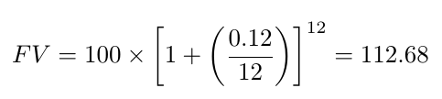
The effective annual interest rate
However, APRs are NOT the appropriate rate to use in present and future value calculations
APR does not accurately reflect the actual interest earned or paid
Example: if you had $100 and invested it for one year at a rate of 12% p.a. compounding monthly, how much would you have at the end of the year? What rate of return have you earned on your money?
You have earned an effective rate of 12.68% instead of 12%

Slide 42
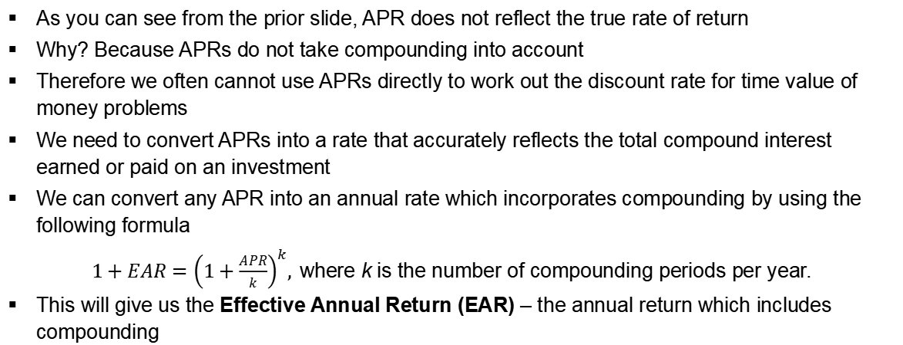
The effective annual interest rate
As you can see from the prior slide, APR does not reflect the true rate of return
Why? Because APRs do not take compounding into account
Therefore we often cannot use APRs directly to work out the discount rate for time value of money problems
We need to convert APRs into a rate that accurately reflects the total compound interest earned or paid on an investment
We can convert any APR into an annual rate which incorporates compounding by using the following formula
$1+EAR={\left(1+\frac{APR}{k}\right)}^{k},$where k is the number of compounding periods per year.
This will give us the Effective Annual Return (EAR) – the annual return which includes compounding

Slide 43
A quick summary
The annual percentage rate (APR) indicates the amount of simple interest earned in one year.
  Simple interest is the amount of interest earned without the effect of compounding.
  In Australia, if an investment quotes as per annum (p.a.) rate, this is generally an APR. This is what we observe.
The effective annual rate (EAR) indicates the total amount of interest that will be earned at the end of one year. (with the effect of compounding)

Slide 44
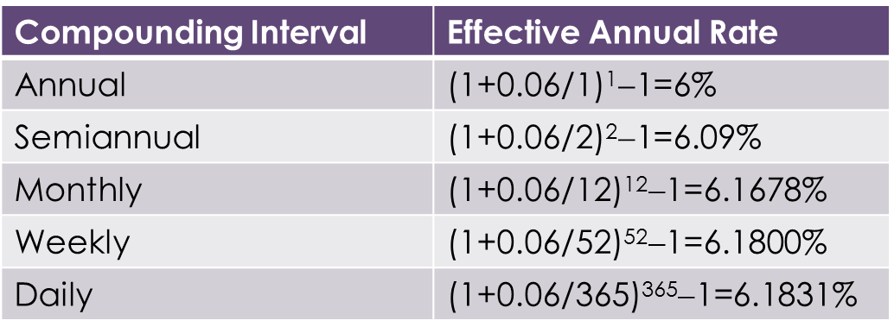
Example with APR=6%
The EAR increases with the frequency of compounding.
Continuous compounding is compounding every instant. When k gets very large, EAR approaches its limit.

Slide 45
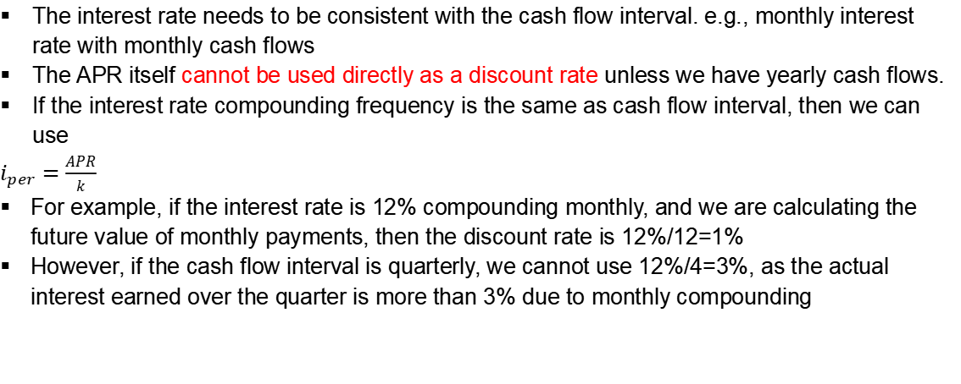
APR → Discount Rate ($i$)
The interest rate needs to be consistent with the cash flow interval. e.g., monthly interest rate with monthly cash flows
The APR itself cannot be used directly as a discount rate unless we have yearly cash flows.
If the interest rate compounding frequency is the same as cash flow interval, then we can use
$i_{per}=\frac{APR}{k}$
For example, if the interest rate is 12% compounding monthly, and we are calculating the future value of monthly payments, then the discount rate is 12%/12=1%
However, if the cash flow interval is quarterly, we cannot use 12%/4=3%, as the actual interest earned over the quarter is more than 3% due to monthly compounding

Slide 46
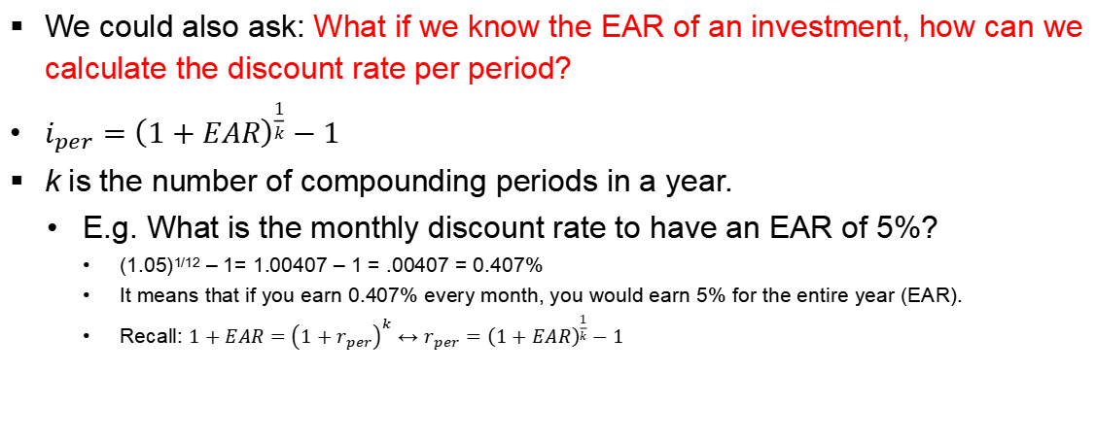
EAR → Discount Rate
We could also ask: What if we know the EAR of an investment, how can we calculate the discount rate per period?
$i_{per}={\left(1+EAR\right)}^{\frac{1}{k}}−1$
k is the number of compounding periods in a year.
E.g. What is the monthly discount rate to have an EAR of 5%?
      (1.05)^{1/12} – 1= 1.00407 – 1 = .00407 = 0.407%
      It means that if you earn 0.407% every month, you would earn 5% for the entire year (EAR).
      Recall: $1+EAR={\left(1+r_{per}\right)}^{k}$ ↔ $r_{per}={\left(1+EAR\right)}^{\frac{1}{k}}−1$

Slide 47
The effective annual interest rate
When you are faced with a time value of money question, you need to look at three things:
  Cash flows
  Discount rate
  Time
You need to match the timing of the cash flows and the compounding frequency of the discount rate
The frequency of cash flows determines the time periods that need to be used

Slide 48
The effective annual interest rate
Example: You have just bought a new car and taken out a loan . You will make annual payments for a car for three years. You have been quoted a rate of 6% p.a. compounding monthly
Does the timing of the cash flows and the rate match?
NO – the cash flows are annual, but the loan compounds monthly
So to do this calculation, you first need to convert the monthly APR into an EAR

Slide 49
The effective annual interest rate
We can use this concept to convert any rate from one compounding frequency to another
Example: You want to buy a new TV and are considering two options. The first is you will pay $1,500 today. The second option is to make a payment plan where you will make monthly payments of $100 for two years, starting at the end of this month. You have been quoted a rate of 6% p.a. compounding quarterly.
Let us consider the payment plan first
How frequently are payments made?
How frequently does the rate compound?
Do these two match? What do we need to do?
Notes:
Monthly
Quarterly
No – need to convert rate to a monthly rate

Slide 50
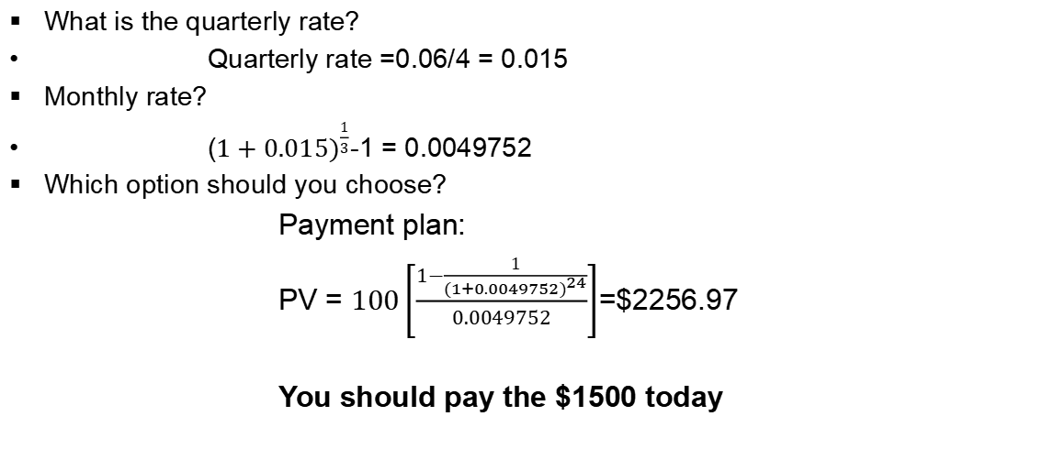
The effective annual interest rate
What is the quarterly rate?
Quarterly rate =0.06/4 = 0.015
Monthly rate?
($1+{0.015)}^{\frac{1}{3}}$-1 = 0.0049752
Which option should you choose?
            Payment plan:
            PV = $100\left[\frac{1−\frac{1}{{(1+0.0049752)}^{24}}}{0.0049752}\right]$=$2256.97
            You should pay the $1500 today
Notes:
Monthly
Quarterly
No – need to convert rate to a monthly rate

Slide 51
Perpetuities, Annuities,
and Special Cases

Slide 52
Perpetuities
When a constant cash flow will occur at regular intervals forever it is called a perpetuity.
Say you deposit $100 in an account paying 5% and withdraw the interest every year:
The infinite stream of $5 must be worth the $100 you deposit today
0
1
2
∞
−$100
$5
$5
…
$5
Notes:
So if r is the correct interest rate (market clearing), then we know that the perpetuity (C) with a PV of 100 is 100x5% or PV x r

Slide 53
Perpetuities
More generally…
0
1
2
∞
C
C
…
C
Notes:
No subscript because all the C’s are the same

Slide 54
Example
You want to endow a chair for a female professor of finance at your alma mater. You’d like to attract a prestigious faculty member, so you’d like the endowment to add $100,000 per year to the faculty member’s resources (salary, travel, databases, etc.) If you expect to earn a rate of return of 4% annually on the endowment, how much will you need to donate to fund the chair?

Slide 55
Solution
This is a perpetuity of $100,000 per year. The funding you would need to give is the present value of that perpetuity.
You would need to donate $2.5 million to endow the chair.
0
1
2
∞
$100,000
$100,000
…
$100,000

Slide 56
Annuities
When a constant cash flow will occur at regular intervals for a finite number of periods (N), it is called an annuity.
0
1
2
N
C
C
…
C
To simplify this, consider a bank account like we used to illustrate perpetuities.
If you withdraw principal and interest at the end of N years, the present value is still $100
Notes:
No subscript because all the C’s are the same

Slide 57
Present Value of an Annuity
The 20-year stream of $5 plus $100 in 20 years must be worth the $100 you deposit today
0
1
2
20
−$100
$5
$5
…
$5
$100

Slide 58
Present Value of an Annuity
Let’s call the initial deposit amount P, and the regular payment amount C
Remember that we constructed the annuity so that the cash flow (C) is equal to (r × P) so P=C/r
Notes:
So if r is the correct interest rate (market clearing), then we know that the annuity (C) with a PV of (100 – PV(100 in N years) is 100x5% or PV x r
NB: the formula will be on your formula sheet in the format highlighted in blue. However it may be quicker in your calculator to use the format with –n in the exponent

Slide 59
Example
You win $2 million, and can choose from the following payout schedules:
  $2 million NOW
  $172,000 per month for 12 months starting 1 month from now
Which is the best alternative?
    Assume your monthly interest rate is 0.5%
  2m now
  $172,000 per month

Slide 60
Solution
PV of $2m today is $2m. Compare this to PV of $172k/month.
$172k
$172k
$172k
$172k
$172k
$172k
$172k
$172k
$172k
$172k
$172k
$172k
0
1
2
3
4
5
6
7
8
9
10
11
12
Take $2m now!

Slide 61
What if…
How would your answer change if the $172,000 payments were at the beginning of the month instead of the end of the month?
PV would be lower, but no change to decision
PV would be lower, need to re-calculate
PV would be higher, need to re-calculate
PV would be higher, but no change to decision
k

Slide 62
Solution
$172k
$172k
$172k
$172k
$172k
$172k
$172k
$172k
$172k
$172k
$172k
$172k
0
1
2
3
4
5
6
7
8
9
10
11
12
Take $172k/month!
Notes:
How would timeline change? (1st click animates moving each payment back one period)

Slide 63
Future Value of an Annuity

Slide 64
Annuity Example
You want to be able to buy a yacht when you retire in 20 years
    You can afford to make quarterly payments of $1,250 into your bank account (first payment 3 months from now)
    Assume your bank account pays 1.75% every quarter
    How much will you be able to spend on your yacht?
0
1
2
20×4
$1250
$1250
…
$1250

Slide 65
Try it…
How would your answer change if you could make your $1250 deposits at the beginning of each quarter instead of the end?
Your first payment would be today, and your last payment would be one quarter before you purchase the yacht
214,742.28
218,500.27
222,324.02
No idea
k
Notes:
Discuss why earlier payments will earn more interest, therefore FV will increase.

Slide 66
Solution
Qtr
0
1
2
79
80
$1250
$1250
$1250
…
$1250
Notes:
Compared to payments at the end of each quarter, we lose the payment in period 80 (which earned no interest), and gain a payment in period 0 (today) which earns 80 quarters of interest. Alternatively, each payment earns one period more interest.

Slide 67
Growing Perpetuities
Assume you expect the amount of your perpetual payment to increase at a constant rate, g.
Present Value of a Growing Perpetuity
0
1
2
3
n
C
C×(1+g)
C×(1+g)²
…
C×(1+g)^{n-1}
…
Notes:
Note that r must be strictly greater than g (or else denominator is zero or negative)

Slide 68
Try it out…
Recall the example on earlier slides.
Given an interest rate of 4% per year, the required donation was $2.5 million. The University has asked you to increase the donation to account for the effect of inflation, which is expected to be 2% per year.
How much will you need to donate to satisfy that request?
$2.5m
$5m
$7.5m
$10m

Slide 69
Solution
The cost of the endowment will start at $100,000 and increase by 2% each year. This is a growing perpetuity.
You would need to donate $5.0 million to endow the chair.
0
1
2
3
n
$100,000
$100,000
×1.02
$100,000
×1.02²
…
$100,000
×1.02^{n-1}

Slide 70
Growing Annuities
The present value of a growing annuity with the initial cash flow C, growth rate g, and interest rate r is defined as:
    Present Value of a Growing Annuity

Slide 71
Example
Your employer is required to put 9.25% of your salary into superannuation (a retirement account)
Assume you graduate and get a job paying $60,000 per year. You have 40 years until retirement and your salary should grow by 3% per year.
Assuming your superannuation account earns 5% per year, How much will you have when you retire?
    For simplicity, assume payments into the account are at the end of each year, and ignore the 15% tax.
Notes:
Note that all contributions attract tax at 15%. Income is also taxed at 15%, but due to dividend imputation the effective tax rate may be much lower.
60,000 growing at 3% for 40 years implies an ending salary of $195,000+

Slide 72
Solution
The contribution at the end of the first year will be 60,000×0.0925=$5,550
Will this be enough?
Notes:
Remember that prices will be higher then too. $1m may not be enough, but you will probably have savings outside of superannuation as well (such as home equity).

Slide 73
Solving Time Value Problems
Spreadsheet/Financial Calculator
Solving for other variables

Slide 74
Using a Spreadsheet
Spreadsheets and financial calculators simplify the calculations of TVM problems
    Excel Functions: NPER, RATE, PV, PMT, FV
These functions all solve the problem:
Notes:
Note that because the equation equals zero, some terms will be positive and some terms will be negative. Convention is to make outflows negative. So if you’re borrowing money the payments are negative and the initial amount borrowed is positive.

Slide 75
Using Excel
How much will you have in 15 years if you deposit $500 at the end of each year into an account paying 5.2% annual interest?
Notes:
Excel formula =FV(0.052,15,-500,0) – the pv is optional

Slide 76
Solving for Other Variables
If you know PV or FV, but have to work out any of the other variables (n, r, C), just substitute what you know into the formula, and solve for the unknown
For example, if you borrow $20,000 from the bank and promise to repay the loan in 10 equal annual installments at an interest rate of 5%:

Slide 77
Solving for r
If you can borrow $20,000 with one repayment of $25,000 at the end of 10 years, what interest rate are you paying?
What do we know?
    PV=20,000; FV=25,000; n=10
Notes:
In some situations, you know the present value and cash flows of an investment opportunity but you do not know the internal rate of return (IRR), the interest rate that sets the net present value of the cash flows equal to zero.

Slide 78
Solving for r
Where the cash flows include an annuity, solving for r algebraically can be difficult or impossible
    Use a spreadsheet or financial calculator!
What’s the interest rate on a $20,000 loan with 10 annual payments of $2,500?
Notes:
Excel formula: =Rate(10,-2500,20000)

Slide 79
Solving for n
You deposit $10,000 in an account paying 5% per year. How many years until you have $20,000 in the account?
Notes:
If interest is only paid and credited annually, you’ll have to wait until the end of the 15th year to have over $20,000 (14 years 2.5 months is during year 15).

Slide 80
Try it out…
Today is Stanley’s 55th birthday. He plans to retire on his 65th birthday. He wants to save the same amount each year, starting today and ending on the day he retires. Then, starting on his 66th birthday he wants to withdraw $10,000 each year ending on his 85th birthday. He can earn 10% on his savings.
How much must each savings deposit be?

Slide 81
Step 1: Draw a timeline
D
D
D
D
D
D
D
D
D
D
D
W
W
W
W
W
W
W
W
W
W
W
W
W
W
W
W
W
W
W
W
55
60
65
70
75
80
85
Over the entire period Stanley will make:
10 deposits and 20 withdrawals
11 deposits and 20 withdrawals
11 deposits and 19 withdrawals
10 deposits and 19 withdrawals
Not enough information
Notes:
Correct method is EndYear-BegYear+1 : 65-55+1=11; 85-66+1=20

Slide 82
Step 2: Formulas
D
D
D
D
D
D
D
D
D
D
D
W
W
W
W
W
W
W
W
W
W
W
W
W
W
W
W
W
W
W
W
55
60
65
70
75
80
85
Which strategy works:

Slide 83
Step 3: Solve
D
D
D
D
D
D
D
D
D
D
D
W
W
W
W
W
W
W
W
W
W
W
W
W
W
W
W
W
W
W
W
55
60
65
70
75
80
85
Of the 5 variables in our equation (D, W, r, n₁, n₂) we know 4 and must solve for the fifth:

